Slide 1

DOC IC HackaTZon
Kickoff Meeting
Presenters:
Danny Duran, Cisco Project Manager, Technical Writing
Betsy Walters, ICD Sr. Technical Writer
July 9, 2024

Slide 2
Agenda
Doc IC HackaTZon
Prerequisites
OneAccess
CSOne & Skills Rating
Creating a Doc IC SR
Brief Introduction to Gen AI for Technical Writing
Questions?

Slide 3
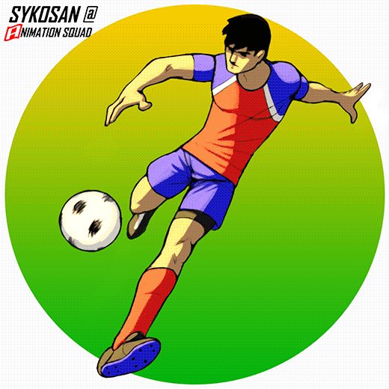
Doc IC HackaTZon

Slide 4
Steps to the HackaTZon
Three Articles
Bring 3 ideas or 3 articles that you wrote on your own.
Create Doc IC SR for each article.
The Title of each SR must begin with HTZ:07:2024
Reviews
First: Technical Leader/SME Review.
Second/Final Review: TW Review.
You cannot be your own reviewer.
1
2
3
4
5
Finish Prerequisites.
Publication
Presentations
To qualify as a Self-Publisher, you must author and publish to Cisco.com 3 original articles.
The Tech Writers show you how to publish your articles.
Your writing needs to improve over the course of the HackaTZon.
CSone access. Tech Zone access
Select skills in Csone and then rate each skill.
Attend 3-Day HackaTZon presentations.
Get copy of slide deck & HackaTZon User Guide.
Both have important information and helpful links.
Notes:
Click. Rapid Click. Click. Rapid Click. Click. Rapid Click. Click. Rapid Click. Click. Rapid Click. 10 Clicks

Slide 5
July HackaTZon 2024
Begin the SR title with HTZ:07:2024. If it doesn’t it will not be submitted to the queue for TW review and publishing.
Use the CSOne cases to track your participation, so your time is completely accountable.
You cannot request SP until you are selected to be an SP by the HackaTZon committee.
5
July 2024 HackaTZon Kickoff
Notes:
7 clicks for fly-in statements.

Slide 6
Self Publisher Requirements
The requirements for being selected for the SP role are:
Attend all 3 presentations over the 3-day HackaTZon event. There are two presentations each day, but you must attend one presentation a day.
Demonstrate that you know how to move your Doc IC SR Case through the CSOne publication stages.
A Technical Leader or Expert reviews and approves all 3 of your articles.
You must make the corrections and changes the Tech Writer indicates in your article.
Your writing should improve during the HackaTZon. In other words, learn from your mistakes, correct them, and try not to repeat them.
6

Slide 7

Any questions?
7
July 2024 HackaTZon Kickoff

Slide 8
Prerequisites

Slide 9
Prerequisites
These prerequisites must be completed before the first day of the HackaTZon event. This presentation goes over how to do each of these:
Go to OneAccess and request access to CSOne and Tech Zone.
Go to CSOne and setup this technology package: Global Doc IC Creation package.
In CSOne, in the Global Doc IC Creation package, select and rate these skills: CREATION_IC_DOCUMENT & IC_EVALUATION
  Create a Doc IC SR for each of your articles and move the SR in CSOne.
9

Slide 10
OneAccess

Slide 11
OneAccess / Tech Zone
Cisco's OneAccess Request Tool is where you request access to Tech Zone or CSOne or other Cisco sites and tools.
You must have attempted to visit Tech Zone at least once prior to requesting access before it is granted.
For more information about access and requesting access and tools, see the article, Managing User Roles via OneAccess*.
    * Very helpful article.
July 2024 HackaTZon Kickoff
Notes:
Click. Click. Click. Click.

Slide 12
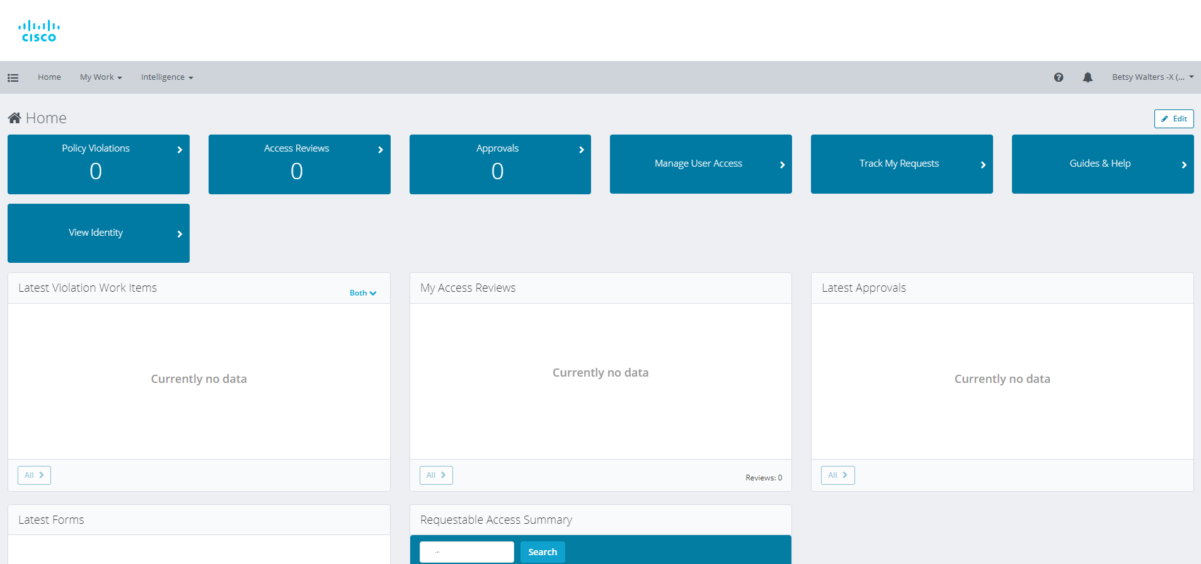
OneAccess Requests
To request access to Cisco tools, roles, and sites such as CSOne:
Click the link: https://oneaccess.cisco.com/home.jsf to display
the OneAccess home page.
Menu
1
12
July 2024 HackaTZon Kickoff
Notes:
Click. Click.

Slide 13
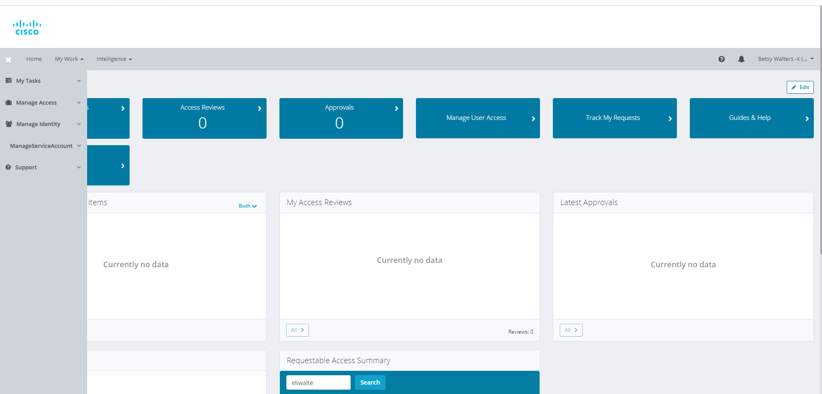
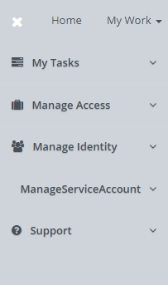
OneAccess Requests
2
2. Click the Quick Access icon in the upper left corner of the screen
to display the left-side menu.
13
July 2024 HackaTZon Kickoff
Notes:
Click. Click.

Slide 14
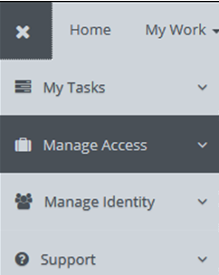
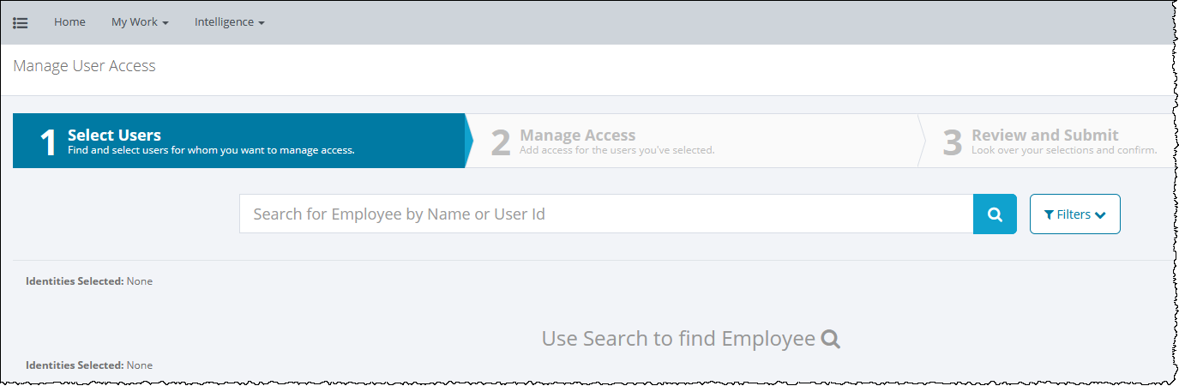

OneAccess Requests
3. From the Manage Access menu, select Manage Access.
4. The Manage User Access screen displays.
3
4
5
5. Enter your employee username (id) in the center text box and click the search icon.
July 2024 HackaTZon Kickoff
Notes:
Click. Click.

Slide 15
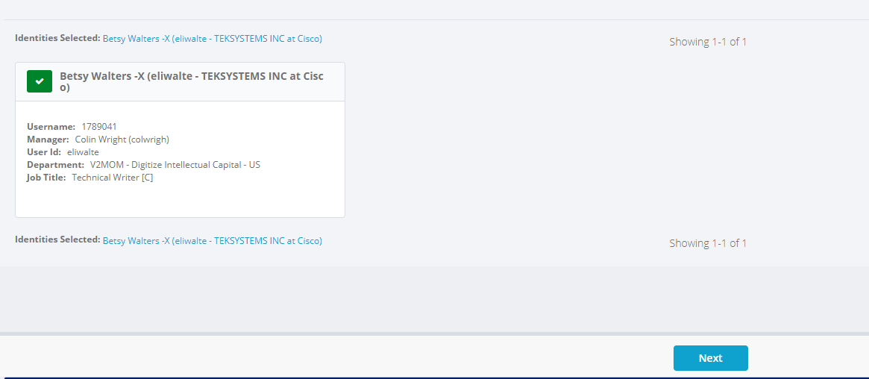
OneAccess Requests
6. When the search results display, click the check box next to your name.
7. Near the bottom of the window, click Next.
6
7
July 2024 HackaTZon Kickoff
Notes:
Click. Click.

Slide 16
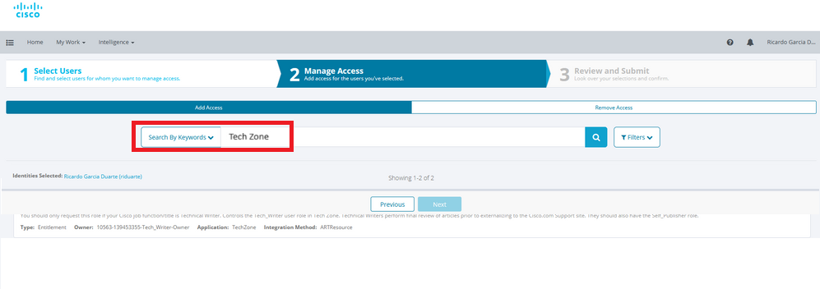
OneAccess Requests
8. When the next screen displays, click in the text box, enter Tech Zone
and click the search icon.
8
Notes:
Click – image rocks.

Slide 17
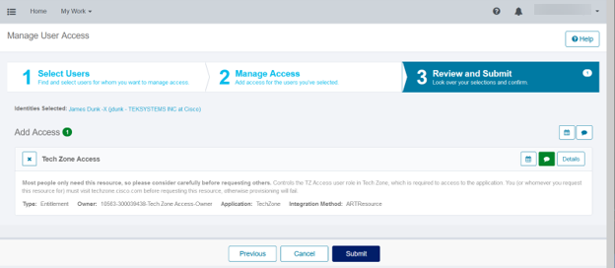
OneAccess Requests
9. When the search results display, click the check box next to Tech Zone Access and click Submit.
10. The request is submitted to your manager for approval.
9
Notes:
Click & image flies out.

Slide 18
CSOne & Skills Rating

Slide 19
CSOne
Ensure you have access to the Global DOC IC package in CSOne so you can select the package and rate these skills:
  IC_CREATION_DOCUMENT
  IC_EVALUATION
  If you do not have access to CSOne, you need to request it from OneAccess.
To select the Global DOC IC package:
Navigate to CSOne:
    https://csone.lightning.force.com/lightning/n/Workmon
Notes:
Click.

Slide 20

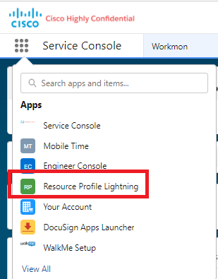
CSOne
Click the App Launcher icon.
2. Select Resource Profile Lightning from the drop-down list:

Slide 21
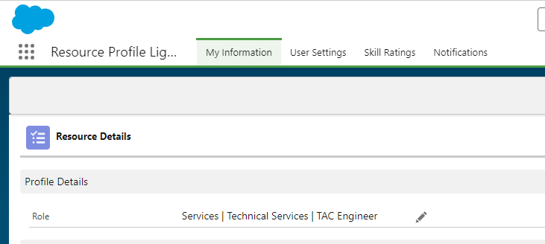
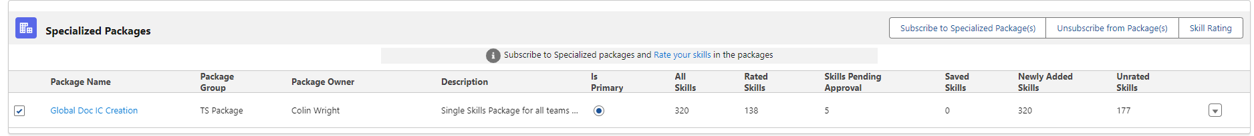
CSOne Package Selection
3. Select the first tab at the top of this page.
It is called My Information.
4. In the Specialized Packages section (near the bottom of the same page), select the Subscribe to Specialized Package(s).
Notes:
Click. Click. Click. Click. Click.

Slide 22

CSOne Package Selection
5. This opens the Skill Packages window.
6. Under the heading Package Group, check the box next to TS TAC.
7. Then enter Global Doc IC Creation in the right-hand search field and click Search.

Slide 23
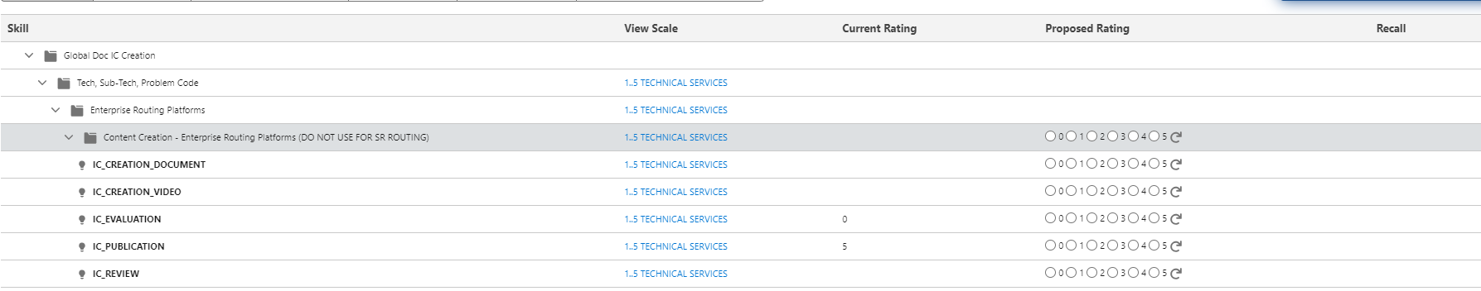
CSOne Package Selection
In the bottom section of Specialized Packages, click the Global Doc IC Creation folder.
This opens the Skills Rating page.
Make sure the package name is Global Doc IC Creation.
In the Skill section, open the folders underneath Global Doc IC Creation.
Open subsequent folders until you see a list of skills:

Slide 24
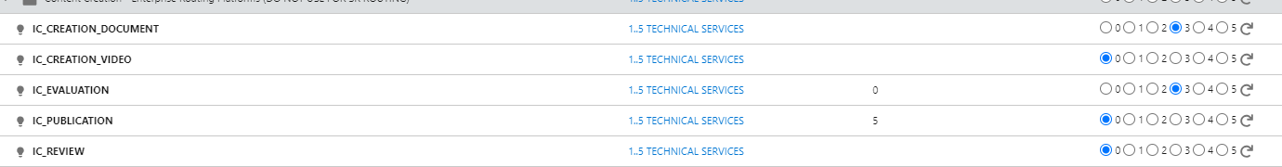
CSOne Skill Rating
From the scale on the right-hand side, toggle a number level you are comfortable with for these skills:
    IC_CREATION_DOCUMENT
    IC_EVALUATION
Do this under each folder category.
You can use the Search & Rate Skills button to search for a rate one skill in each folder as a batch. Then do multiple skills ratings. See next slide.
Skills
Ratings

Slide 25
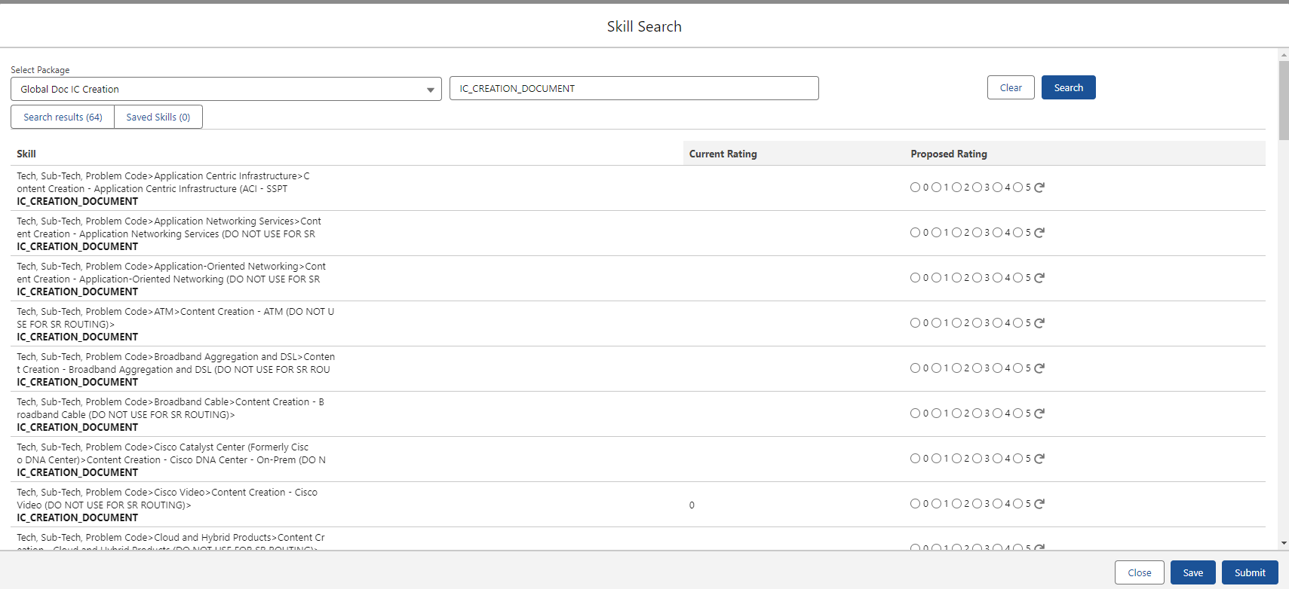
Example of Search Results

Slide 26
CSOne Skill Rating
After rating your skills, select the Submit button to submit your Skills & Ratings for your manager’s approval.
You will get an email when your manager approves your request.

Slide 27
Any questions?

Slide 28
Creating a Doc IC SR

Slide 29
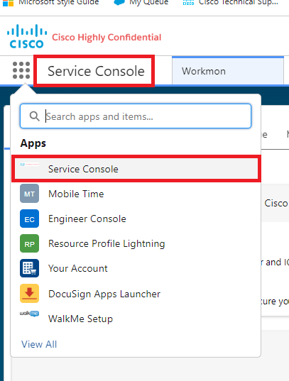
Creating a DOC IC SR Case
You must create a Doc IC SR Case for each article you write.
In Tech Zone, you can link the SR # to your actual article.
To create a Doc IC SR Case:
  Navigate to CSOne – you can be in any view, but Service Console is recommended.
Video of Creating a SR Case (circa 2022)

Slide 30

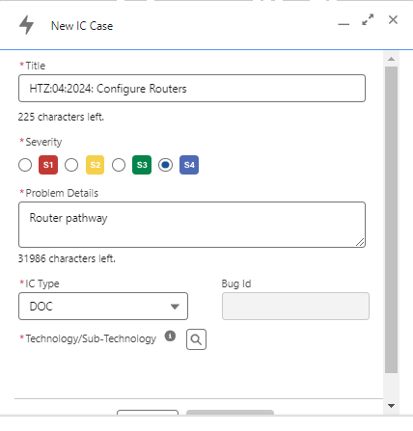
1. In the top, right-hand side of the Service Console screen are these icons:
2. Select the + icon.
3. The New IC Case window opens.
30
July 2024 HackaTZon Kickoff

Slide 31
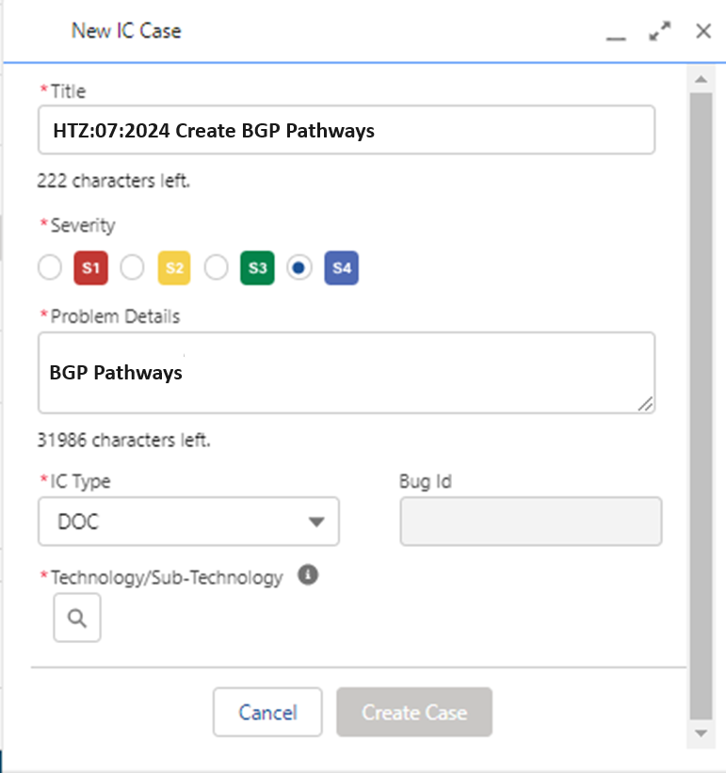
Fill in this window:
5. Click Create Case.
Title of your SR for the
July HackaTZon, prefix
your SR title with HTZ:07:2024
Severity stays at S4
Brief description of SR
IC Type is always DOC
Click on search icon
to find and select
your technology
31
July 2024 HackaTZon Kickoff

Slide 32
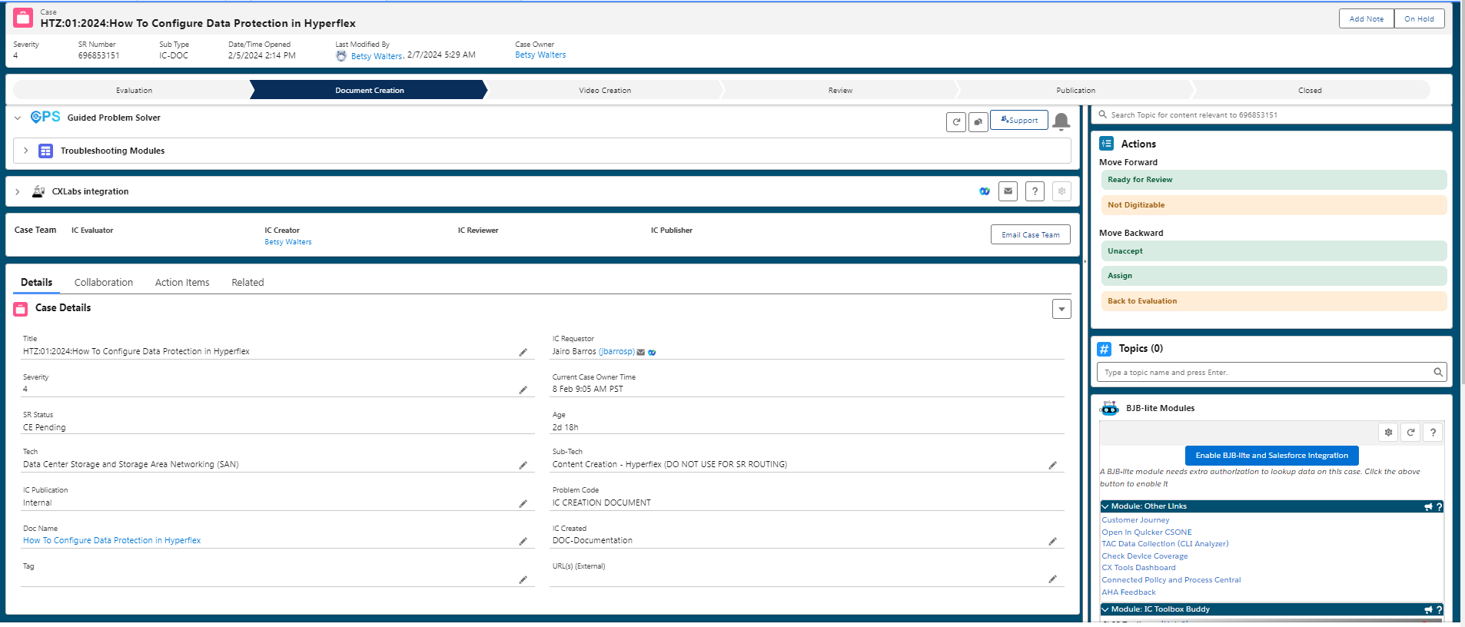
Title of Doc IC SR
Publication Status Bar
Use Actions to Move SR to next Stage
Edit icon
Title of Doc IC SR
1.
Technology of SR
2.
Title of TZ Article*
(Add TZ URL link)
3.
Type of IC
External Cisco.com URL
1. When you click the Edit icon (pencil) for the Doc Name, an additional entry field opens. Enter the Tech Zone URL.
2. Select External for the IC Publication field.
3. Select DOC Documentation for the IC Created.

Slide 33
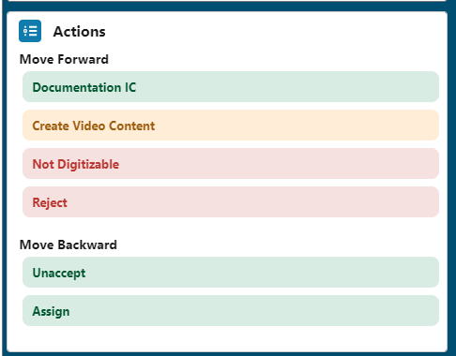
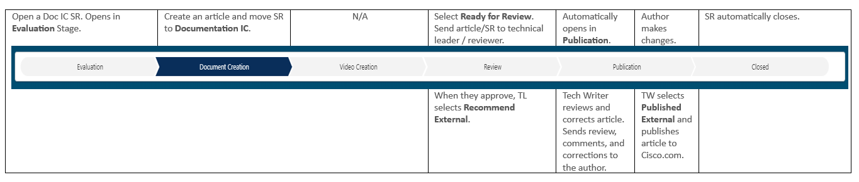
Moving through the CSOne Publication Stages
Use the Actions field to Move SR Forward through the publication stages.

Slide 34
Gen AI for Technical Writing

Slide 35
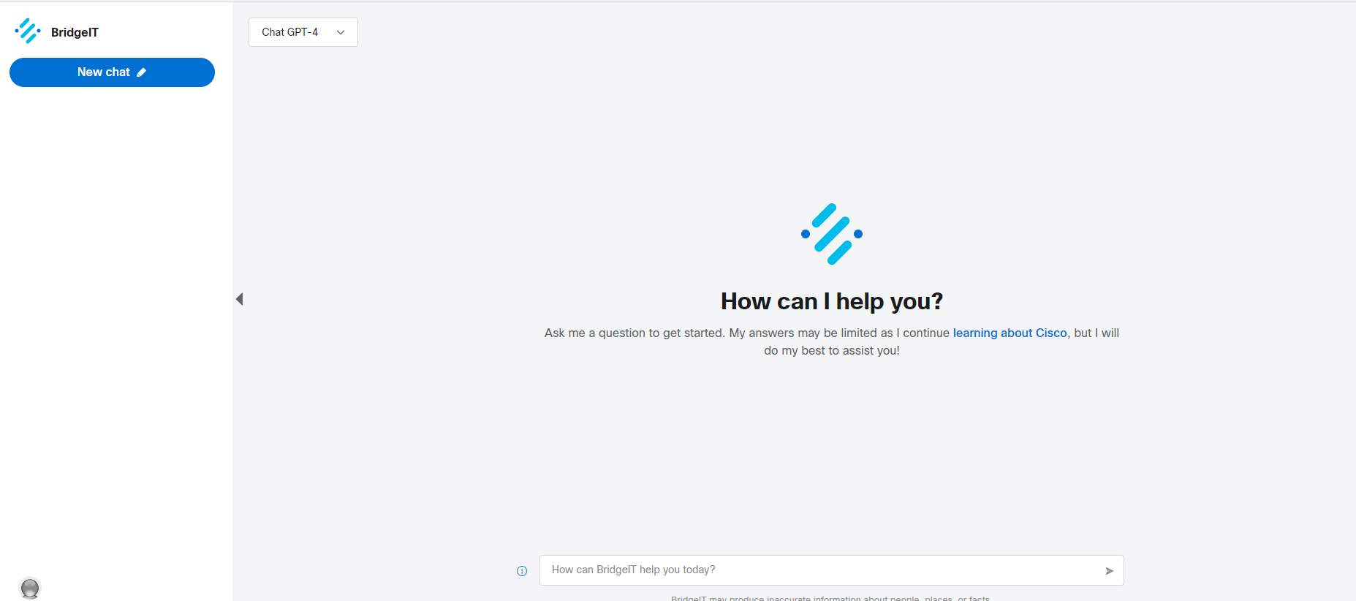
- BridgetIT is Cisco’s Gen AI tool. It is built on Chat GPT-4. But you can use it with Chat GPT-3.5 as well.
- BridgeIT’s knowledge database is up to 2023. 2024 data has not been integrated into BridgeIT yet.
- BridgeIT is a tool that can assist you in your writing or other queries.
Introducing Bridget IT and Gen AI
**Do not expect BridgeIT to produce a final, polished article for you.**

Slide 36
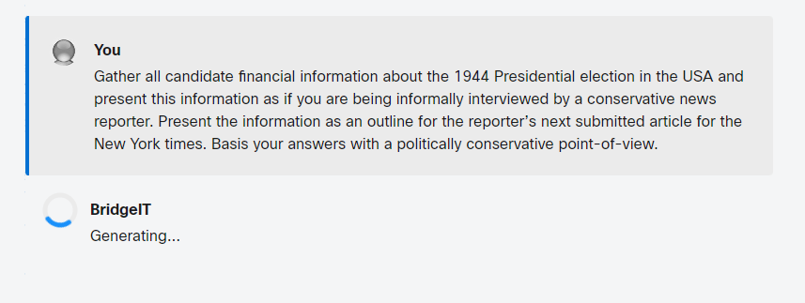
- You must still adhere to Cisco writing standards and the CCW alerts in the Tech Zone and the standards for Cisco.com.
- Use it as a tool to get started on our article or to gather research for your article.
- You still need to check BridgeIT’s output for grammar, spelling, punctuation errors, and incorrect information.
Introducing Gen AI and Tech Writing
**Learn how to write clear and detailed prompts.**

Slide 37
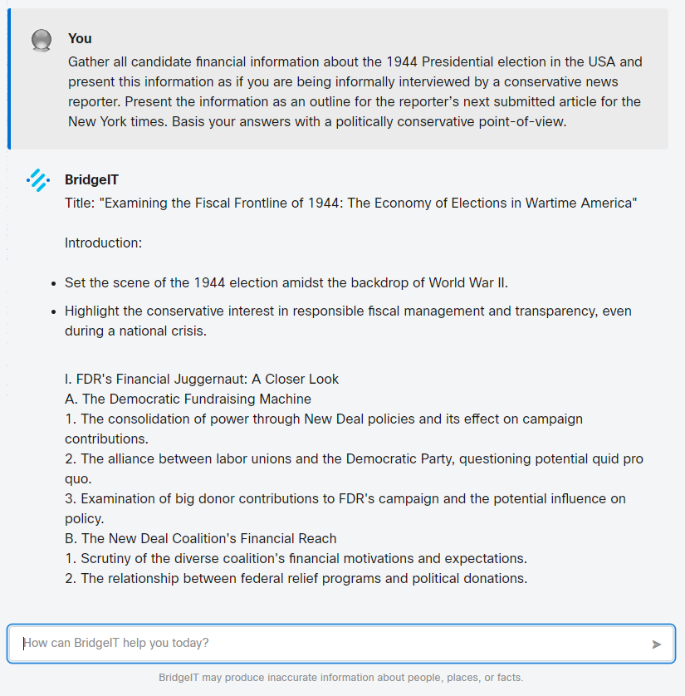
- DO NOT copy/paste materials from BridgeIT directly into your HackaTZon article.
- A Gen AI/BridgetIT workshop is being planned.
- See the Doc IC HackaTZon site for updates.
HackaTZon and Gen AI

Slide 38
The Team

Slide 39
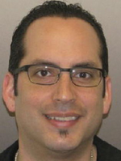

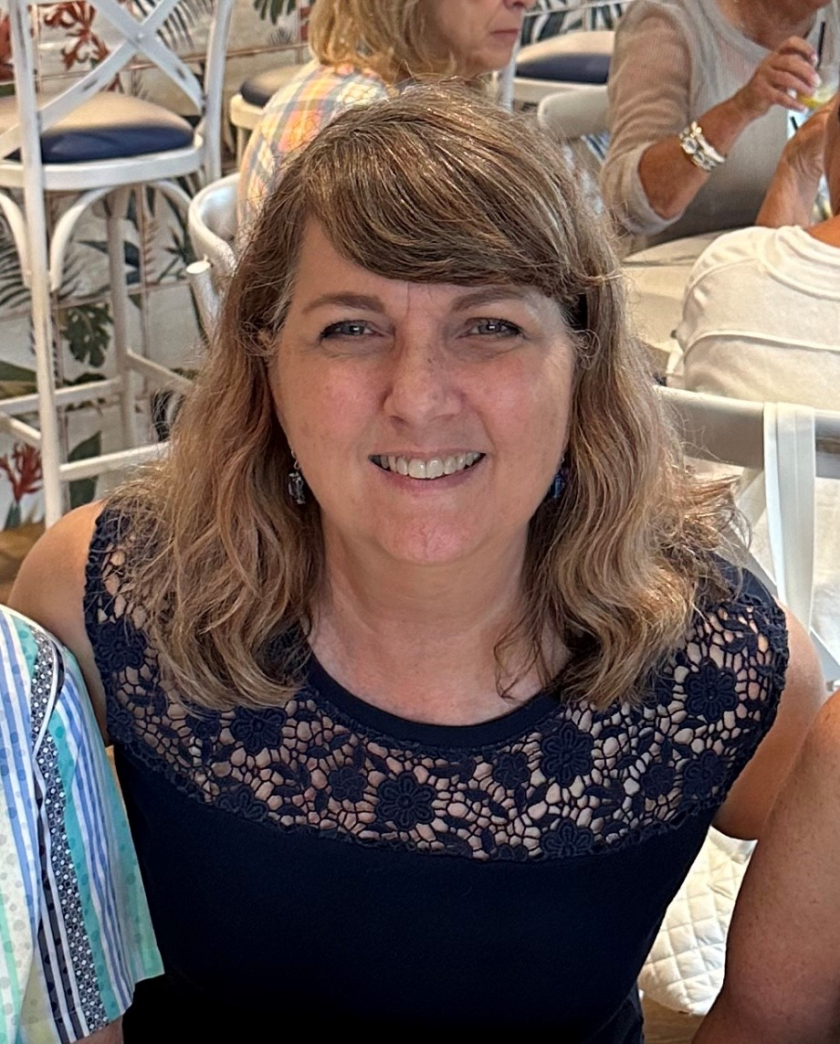
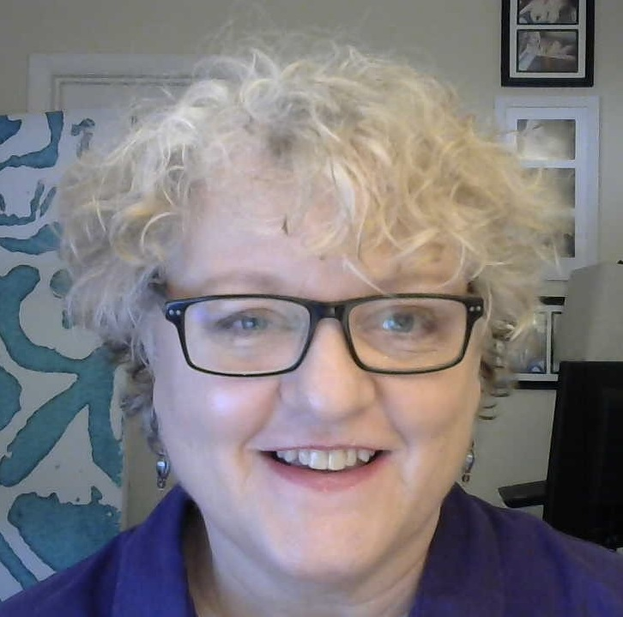
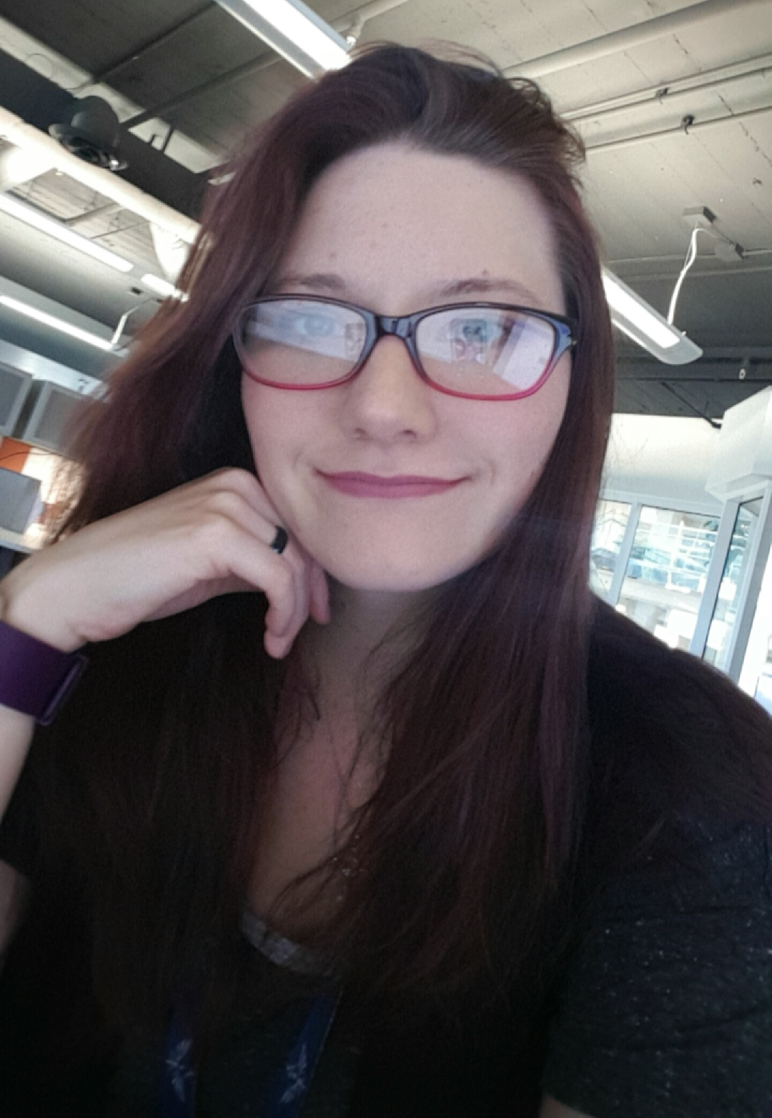
Doc IC Tech Writers / Presenters
Danny Duran
David Frain
Senior Technical Writer
PM, Technical Writing
Freda Schmitt
Senior Technical Writer
Betsy Walters
Rachell Hayes
Senior Technical Writer
Senior Technical Writer
39
July 2024 HackaTZon Kickoff

Slide 40


Any
Questions?
Comments?
Suggestions?
For more information about any of these Tools, don't hesitate to ask an ICD Tech Writer for help.
Notes:
Click. Click.

Slide 41
Sharpen Your Writing Skills
The Sharpen Your Writing Skills workshop is presented this Thursday, July 11, 2024, at 8 am CDT / 10 am EDT.
This workshop gets you ready to write your Tech Zone articles. It also helps you brush up on grammar and punctuation standards as well as Cisco publication guidelines.
We’ll see you there!

Slide 42
See you at the HackaTZon!
Notes:
Click.

